Slide 1
COST Fin AI Country Update: Greece
Athens, October 2021

Slide 2
MC Members Greece
Dr. Veni Arakelian, MC1, Piraeus Bank, Greece
Prof. Mike Tsionas, MC2, Lancaster University
Notes:
2

Slide 3
Other Members (1/2)
Dr Apostolos CHALKIS (member of WG1 and WG3)
Prof Ioannis EMIRIS (member of WG1, WG2 and WG3)
Dr Paraskevi TSOUTSA (member of WG1, WG2 and WG3)
Dr Nikolaos S. THOMAIDIS (member of WG1, WG2 and WG3)
Ms Eleftheria PASCHALIDOU (member of WG1, WG2 and WG3)
Mr Theodoros CHRISTODOULOU (member of WG1, WG2 and WG3)
Notes:
3

Slide 4
Other Members (2/2)
Mr Alexios Ioannis MOUKAS (member of WG1, WG2 and WG3)
Dr Hariton KORIZIS (member of WG1, WG2 and WG3)
Prof Michalis LINARDAKIS (member of WG1 and local organizer of WIFI - IV)
Dr Vasiliki SKINTZI (member of WG3)
Mr Theo ZACHARIS (member of WG3)
Notes:
4

Slide 5
Women in Fintech and AI – 4th Edition

Slide 6
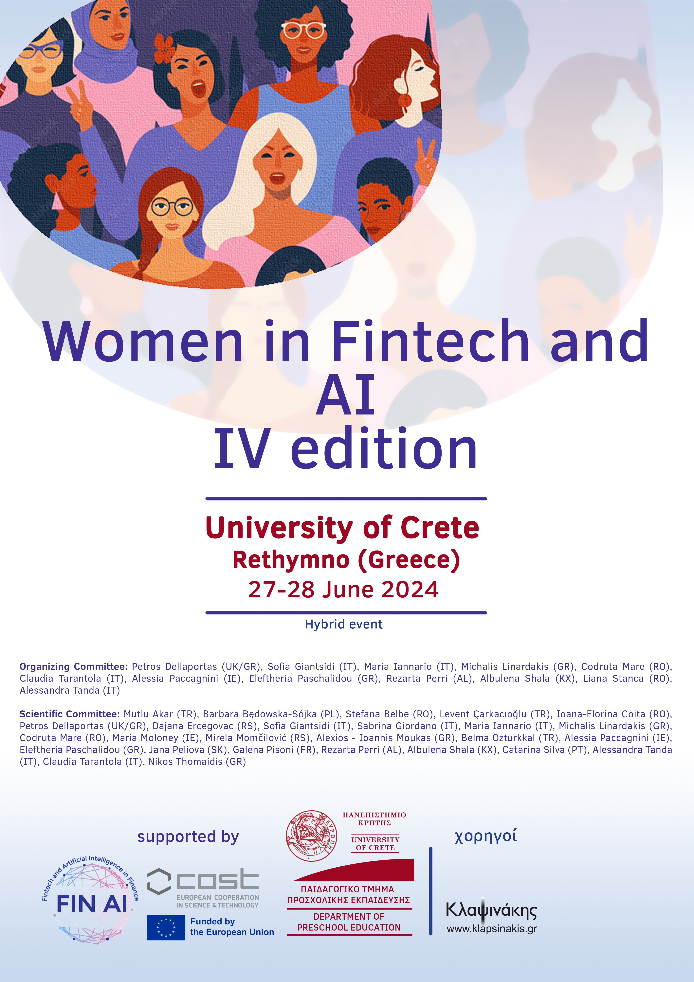
This year’s conference was held on June 27 and 28, 2024, at the Gallos Campus in Rethymnon (Creta) with a focus on the critical role of education in financial technology, as well as inclusion in the financial services sector.
Presentations from WG1, WG2, WG3, and a Core group meeting on COST FinAI Topics Ttook place during this two-day event.
Furthermore, Best WI-FI 2024 award has been given to Stefana Belbe Cioban also a member of the COST action.

Slide 7
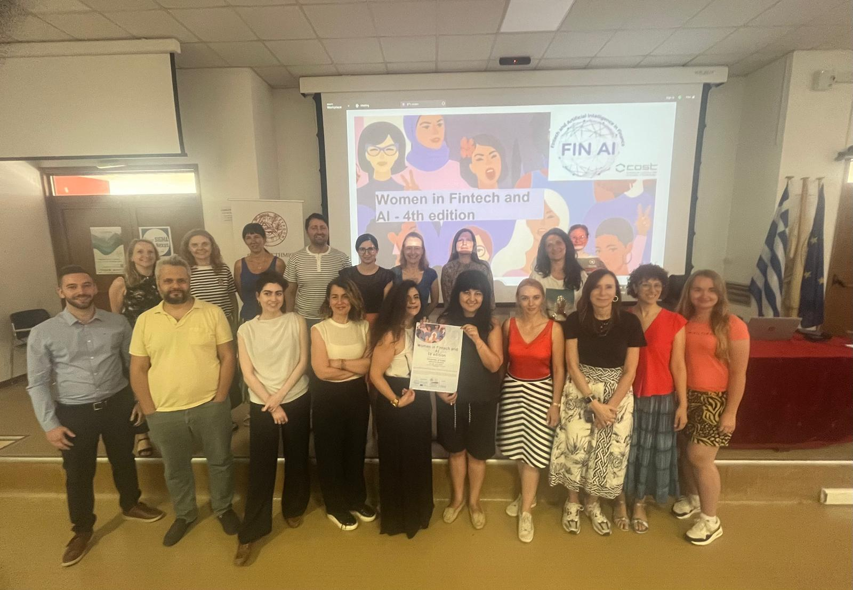
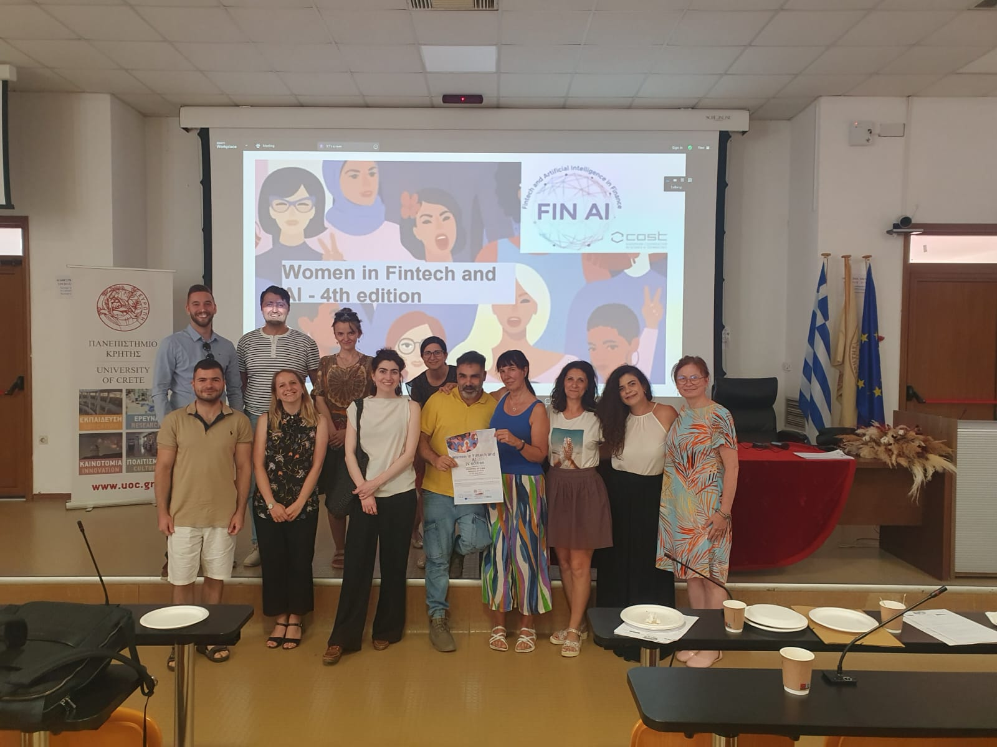
Moments from the Conference

Slide 8
Dissemination of the Action
New publications
Moloney, M., Svetlova, E., Muckley, C., Paschalidou, E. G., Coita, I.F., and Poti, V. (2023). “Assessing AI and Data Protection Expertise in Academia and the Financial Sector: Insights and Recommendations for AI Skills Development”. Journal of Financial Transformation, 58.
Press
Moloney, M., Coita, I.F., Paschalidou, E., Mare, C., Bolesta, K., Będowska-Sójka, B., Stanca, L.M., Filipovska, O., Pisoni, G., Arakelian, V., Osterrieder, J., Svetlova, E., and Muckley, C. “Ethical Artificial Intelligence, Fintech and Data Protection: A Path Forward for Training in Europe”. Submitted to Open Research Europe.

Slide 9
Planned Actions
Informal discussion with Alessandra Tanda for an invited talk in the University of Pavia.
Collaboration and networking with other research communities.
Notes:
9

